Slide 1
Learning intentions and success criteria
I am learning…
I can…
…
…

Slide 2

DDD Revision
N5 – Database Design & Development

Slide 3
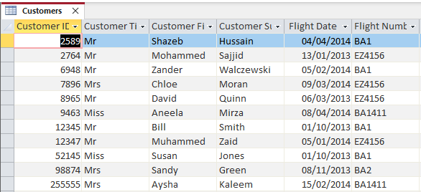
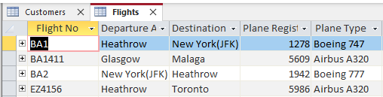
Database Example
Customers Table
Flights Table
3

Slide 4
Tables
A database table may include:
A primary key – the unique identifier for each record:
e.g. Flight No
A foreign key – if the table is linked to another table:
e.g. Plane Type must be a plane in the plane table so it is a foreign key
Attributes (also known as fields):
e.g. Destination, Departure Airport
4

Slide 5
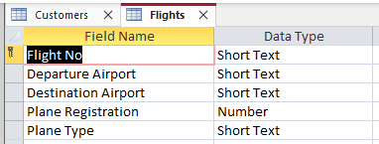
Tables
A database table may include:
Data types:
The type of data for each attribute
(e.g. Text, Number, Currency, etc.)
5

Slide 6
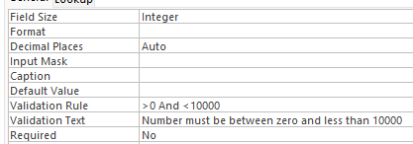
Tables
A database table may include:
Validation:
Presence check (data is required)
Restricted choice (can be one of multiple options)
Field length (how many characters you can type)
Range check (must be between two values)
6

Slide 7
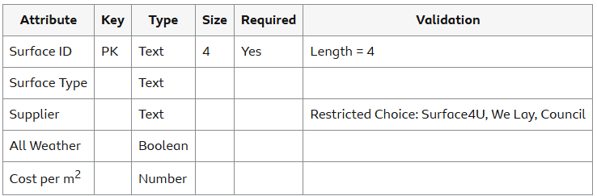
Data Dictionaries
Data dictionaries are created during the design phase to define the structure of a database. They include:
Name of each entity (table)
Name of all attributes (fields)
Data type for each attribute
Size of each attribute
Primary or foreign keys
Validation rules
7

Slide 8

Entity Relationships
Two tables in a database may be related to each other. There are a few types of relationships:
One-to-one
One-to-many
Many-to-many
We will focus on one-to-many relationships.
8

Slide 9
One-To-Many Relationship
Customers Table
In the example:
One flight may have many customers
This is a one-to-many relationship
Flights Table
9

Slide 10
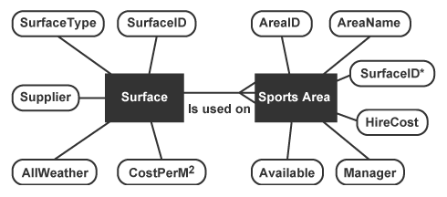
Entity Relationship Diagrams
An ER diagram shows the relationship between multiple entities – it must include:
Each entity
Each attribute for each entity
The cardinality (e.g. one-to-one, many-to-one, etc.)
Description of the relationship (e.g. “is used on”)
10

Slide 11
ER Diagram Example
We first draw a box each entity (table):
Customers
Flights
11

Slide 12
ER Diagram Example
Then, we add each entity in a circle – adding an underline for the primary keys and a star next to foreign keys:
Title
FlightNo*
FlightNo
CustomerID
Departure
Customers
Flights
First Name
Destination
Surname
Plane Reg
Flight Date
Plane Type
12

Slide 13
ER Diagram Example
Finally, we add the cardinality and the description of the relationship (one flight can have many customers):
Title
FlightNo*
FlightNo
CustomerID
Departure
Customers
Can be booked on
Flights
First Name
Destination
Surname
Plane Reg
Flight Date
Plane Type
13

Slide 14
Structured Query Language
SQL queries are used to search, sort, or manipulate a database. There are 4 types you need to know:
SELECT – View specific data
INSERT INTO – Add records into an entity
UPDATE – Update one or more fields in an entity
DELETE – Remove one or more records from an entity
14

Slide 15
SQL: SELECT
Select statements are used to view data from a database – example:
SELECT *
FROM Flights
WHERE FlightNo = “BA1”
This will display all records which match the search criteria.
15

Slide 16
SQL: SELECT
You can add an ORDER BY line to specify alphabetical/numerical order – either ASCencing or DESCending
SELECT *
FROM Flights
ORDER BY Destination ASC
This will display all records sorted by the Destination field from A to Z.
16

Slide 17
SQL: Insert into
This statement adds a record into an existing entity:
INSERT INTO Flights
VALUES (KLM1, Edinburgh, Madrid, 2654, Boeing 777)
When inserting values, they must be in the same order as the entity.
KLM1
Edinburgh
Madrid
2654
Boeing 777
17

Slide 18
SQL: Update
This statement changes the data in existing records:
UPDATE Flights
SET Destination = “Paris”
WHERE Plane Type = “Airbus A380”
If you do not have a WHERE clause then all records will be updated (e.g. all destinations will be Paris).
Paris
Paris
18

Slide 19
SQL: Delete
This statement removes one or more records based on a criteria:
DELETE FROM Flights
WHERE Departure Airport = “Heathrow”
If you do not have a WHERE clause the whole table will be deleted.
19

